Slide 1
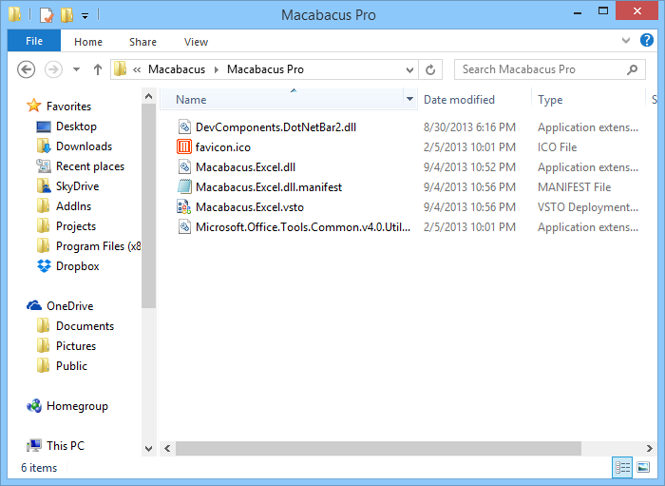
Using Macabacus to Check Presentations
Presentation Proofing
Macabacus can check for missing opening / closing parentheses / brackets (like the one missing here
Macabacus can also flag flag repeated words
It can also check bullet punctuation for consistency.
We can also check for incorrect/inconsistent spacing around slashes/ dashes - this is good
Macabacus will check for missing “quotes, as well as "straight" quotes that do not match the format of “smart” quotes
Here, we have some bullet formatting issues
For example, this bullet is too large
And this one is not properly aligned
This one is just right
Macabacus | Will | Check | Table
Cell | Margins, | Too
Uiweb fuwyebf |  | Iuy wbeuyfbw uy
Footnotes are easy to screw up, but Macabacus helps ensure they are correct⁽²⁾
There are several ways to abbreviate millions and billions
Many people use $23mm, for example. But others might use $23M, or even $23 MM
This bullet contains text that uses the wrong font
This text has the wrong proofing language set
This shape is off the slide
This is a footnote.
This is another footnote.

Slide 2
Macabacus Also Inspects Charts
Presentation Proofing

